Slide 1
INDIAN INSTITUTE OF TECHNOLOGY, MADRAS BS, DATA SCIENCE, AND ITS APPLICATIONS
BUSINESS DATA MANAGEMENT Debtor AND DEMAND FORECASTING FOR A TEA AND HANDLOOM JOB WORK TRADING COMPANY
NISHKARSH DIXIT
21F2001483@ds.study.iitm.ac.in

Slide 2
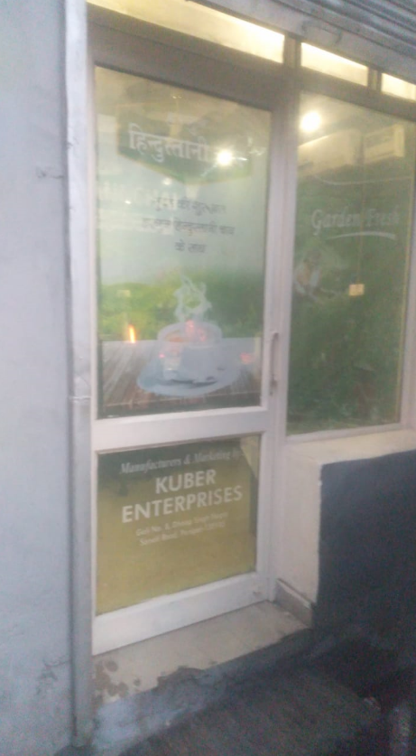
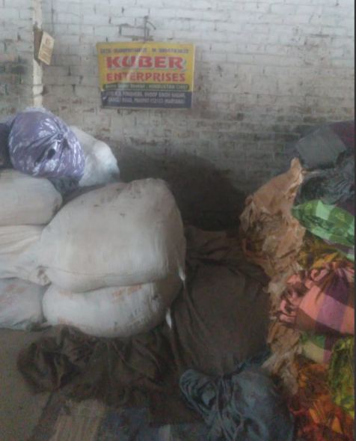
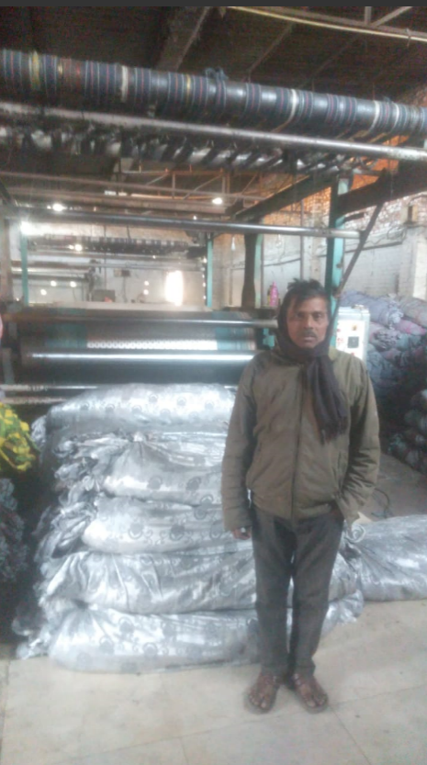
ABOUT THE BUSINESS
Running the business since 1948, Kuber Enterprises is a Panipat-based firm.
They are doing Handloom Job work since 1948 and started the tea business last year only in ending of 2022.
They provide Handloom Job work deals in tea, as well as different items like Jars, kullad cups, Plastic cups, bottles, Noodles Makhanas, etc., to customers and other retailers.
Their customer base includes retailers in every part of North India. They offer an impressive tea collection and Handloom job work. Their range of business starts from Bikaner and goes to Lucknow and from Indore to Jammu.
In 2022, they expanded with Noodles and Makhanas, aiming to increase their business.

Slide 3
BUSINESS PROBLEM
Debtor’s Analysis
Goods are sold on a credit basis, so identification of bad debtors is crucial for the health of the business as late repayment of credit could lead to a shortage of working capital for the firm.
Debtors with high credit value and high repayment periods were identified.
Performance Analysis of Handloom Sales
By printing daily reports of production output, a handloom job work business can track the number of goods produced daily.
This will help you to determine the overall performance of the handloom sales. You can analyze the trend of sales revenue over time, compare the revenue of different products, and identify the most profitable products.
Sales Volume: This measures the total number of products sold. By analyzing the sales volume, you can identify which products are in high demand, and which products need to be marketed better.
Inventory Management System
Best performing SKUs were identified with the help of traded value and profit margins for the SKU.
Inventory turnover for each SKU is the number of times you sell and replace your inventory over a specific period. By analyzing this, you can identify the products that are not selling well and take necessary actions such as offering discounts or discontinuing the product.
Demand Forecasting
This method involves analyzing past sales data to identify patterns and trends that can be used to forecast future demand. This method is suitable when there is a significant amount of historical data available and when past sales trends are likely to continue.

Slide 4
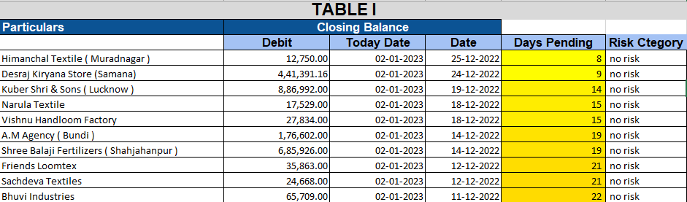
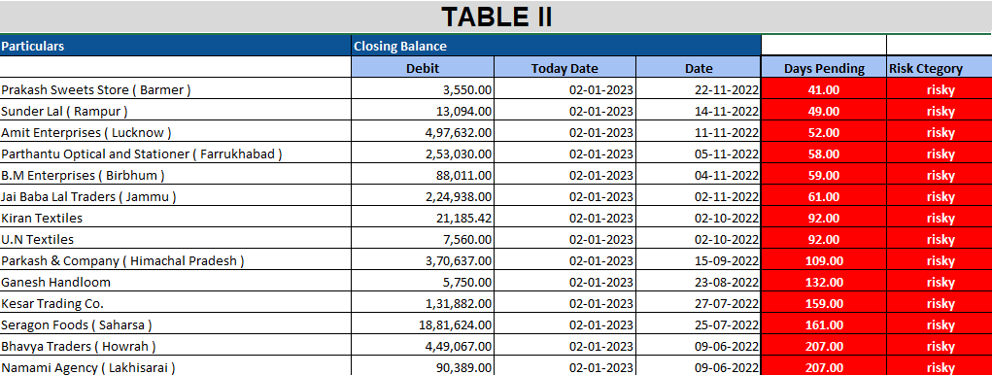
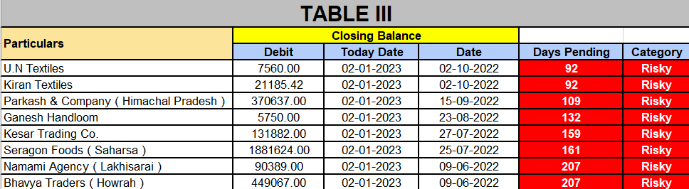
In Table I there are particulars with less risk than
the other.
In Table II there are the particulars that have the higher debtors’ day than the average they are crossing the threshold value which is set up by doing a discussion with the owner.
In Table III there are the Particular with them Trades that have been stopped with these 8 debtors with a bad history of repayments below.
DEBTOR ANALYSIS

Slide 5
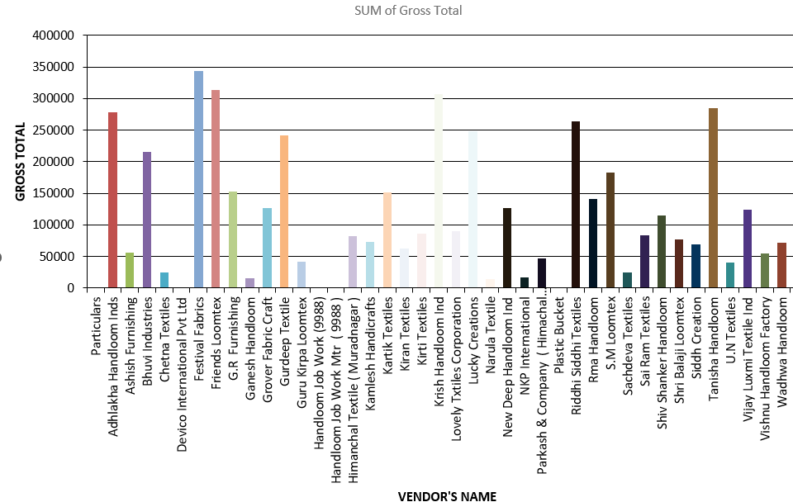
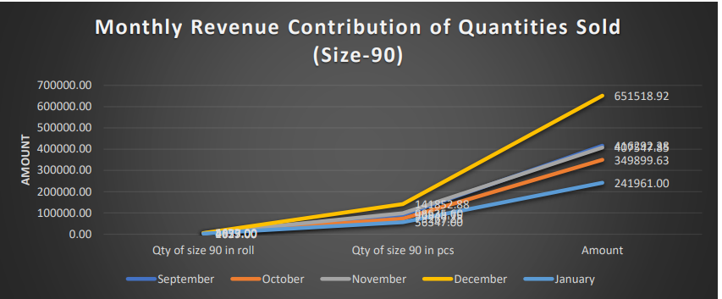
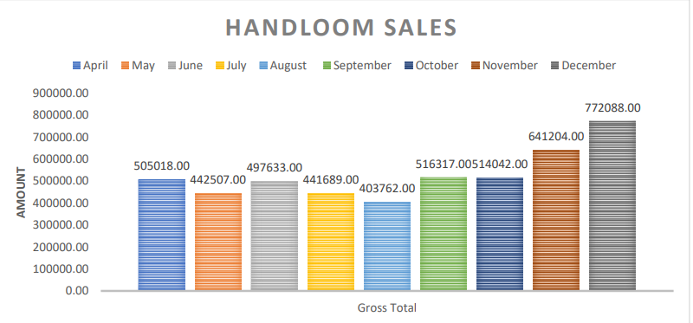
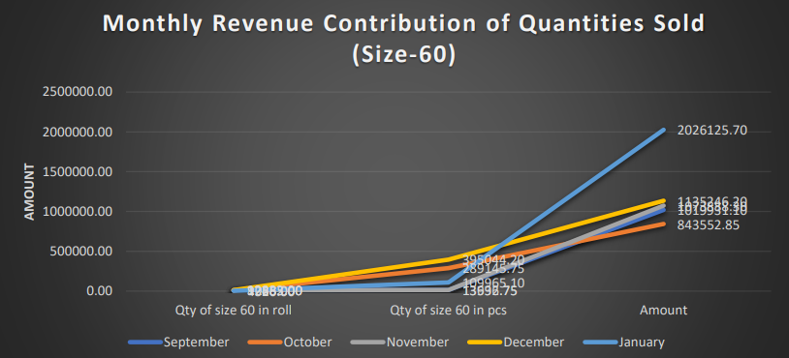
Performance Analysis of Handloom Sales

Slide 6
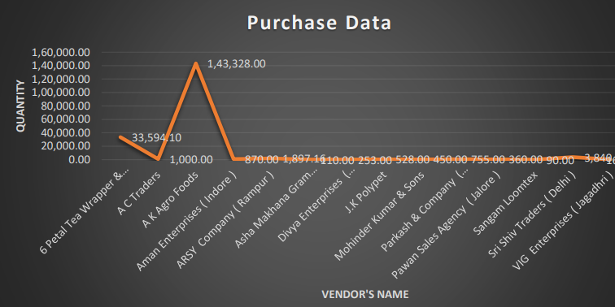
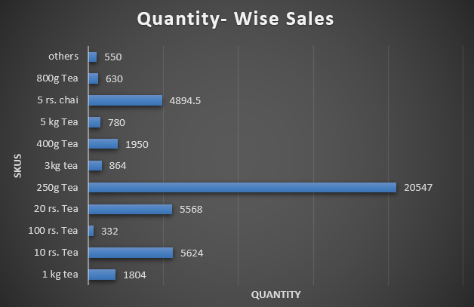
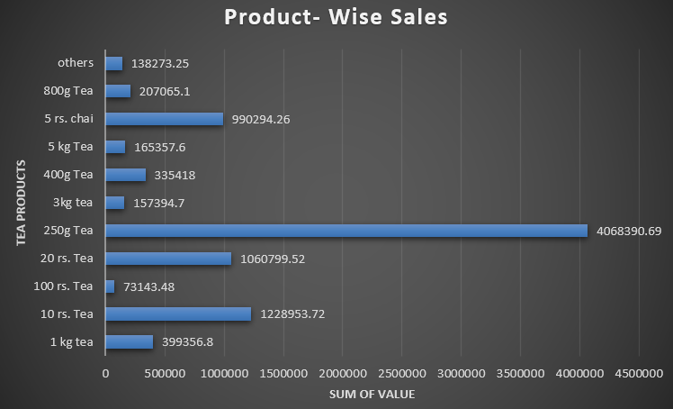
Classification of SKUs

Slide 7
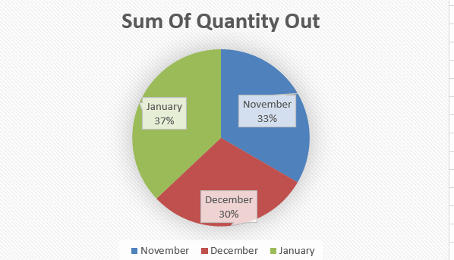
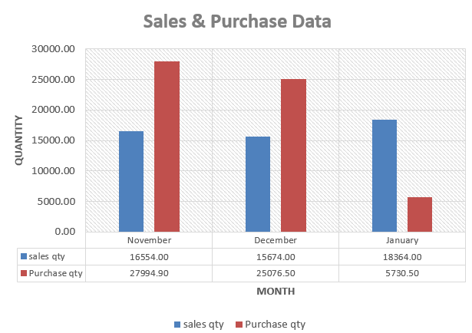
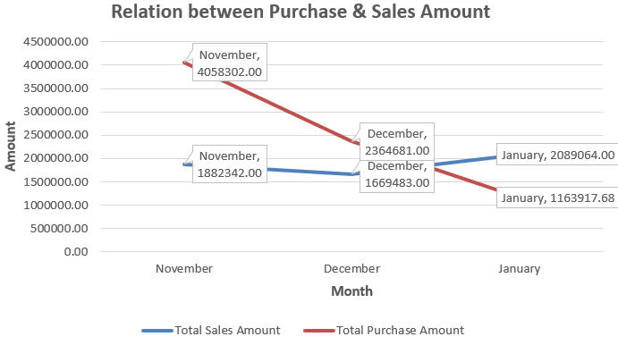
Relation between Revenue generated and purchase

Slide 8
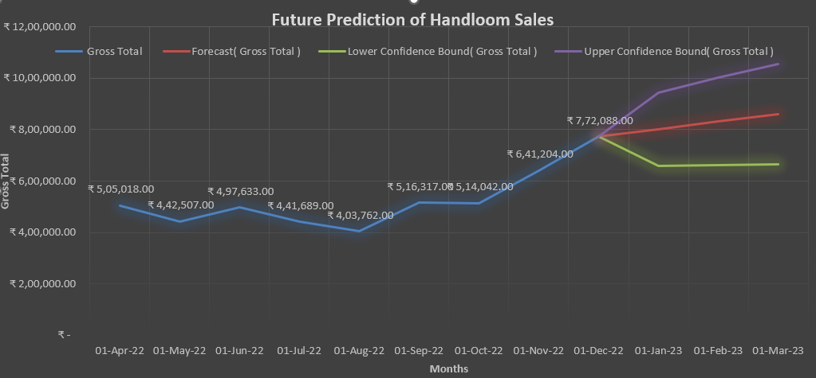
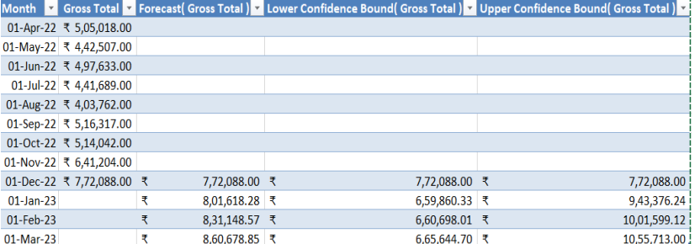
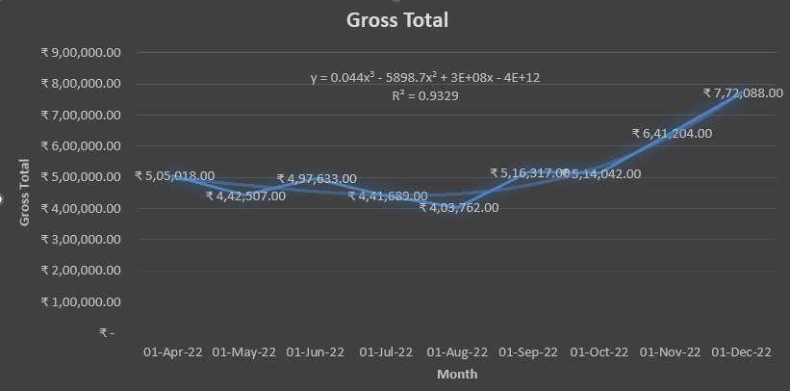
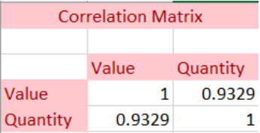
Demand Forecast of Handloom Job Work

Slide 9
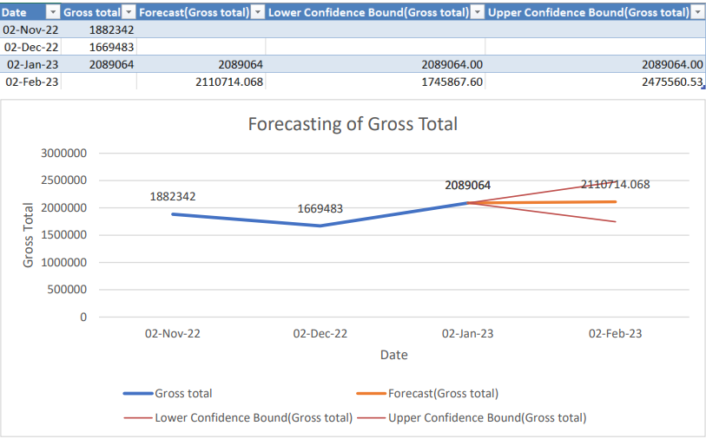
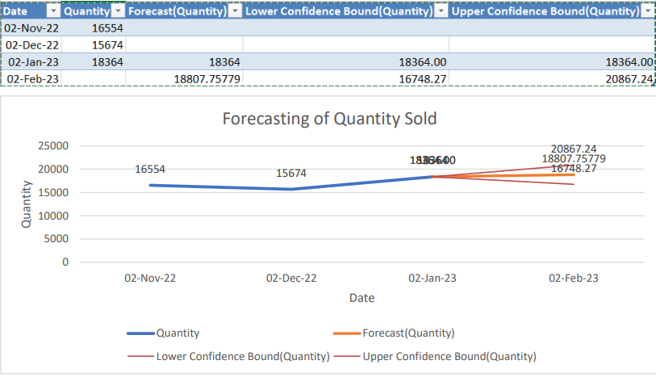
Forecasting of Monthly Quantity Sold and Gross Total of Tea

Slide 10
Interpretations and Recommendations
Aging of debtors: This analysis helps to identify the amount of debt outstanding at different stages of aging, such as 30 days, 60 days, 90 days, or more.
Price Prediction for Handloom Business: Based on historical data and market trends, the price of handloom products is expected to increase in the next few months. It is recommended to conduct regular market research and competitor analysis to stay up-to-date on market trends and adjust prices accordingly.
Demand Forecasting for Tea Business: Based on historical data and seasonal trends, demand for tea is expected to increase in the upcoming months. It is recommended to maintain an adequate inventory of tea products to meet the expected increase in demand.
Promotional campaigns and discounts can be used to stimulate demand during the offseason to help balance the fluctuation in demand. Market research can be used to identify new market segments and expand the customer base.
Analysis of revenue contribution of quantity sold refers to the process of examining the impact of the number of goods sold on a company's revenue. This analysis helps businesses understand how changes in quantity sold can affect their financial performance.
This analysis can provide valuable insights into a business's operations and help them make informed decisions.
Set up policies for ordering, receiving, storing, and tracking inventory. Having these policies in place will help in ensuring that inventory is managed efficiently and effectively.
Data has been analyzed on the basis of the information made available by the firm in my best capacity.
THANK YOU!!

